Slide 1
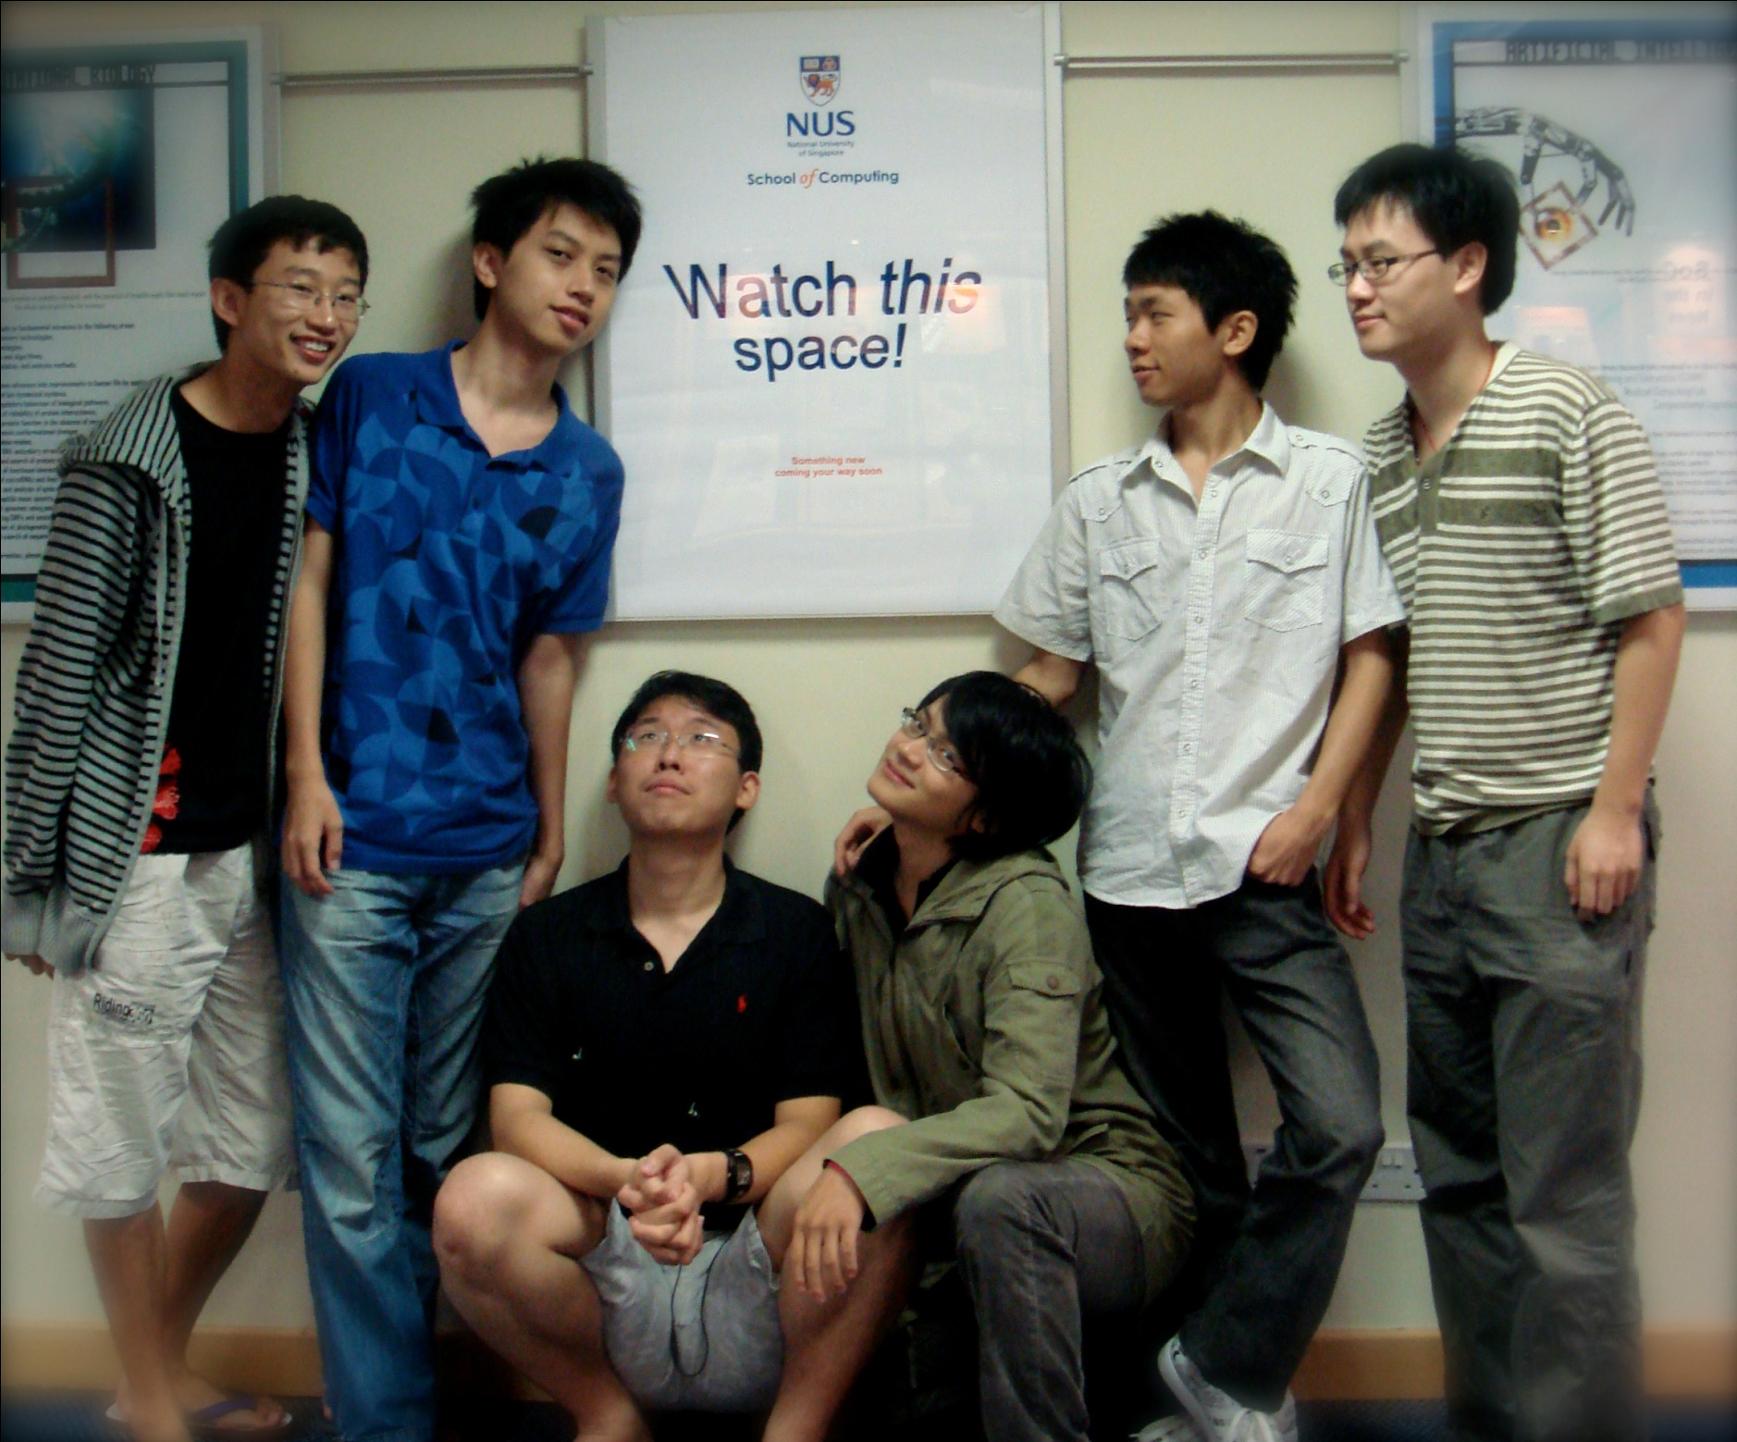
How to work individually effectively in a team setting
Lessons learnt from CS3215
Lightning Talk
0110

Slide 2
Why talking about this
Firstly, it will definitely not the last time you work as a team
Secondly, our presentation is more like a revision of what we have step through, to see the lessons and fun part of it.

Slide 3
Outline
First speaker: Wenhao
Talking about our team, team 9: 0110, about the entire program, how we work together and have fun together.
Second speaker: Shukyi
Giving a summary of what we have learned about teamwork through this course.

Slide 4
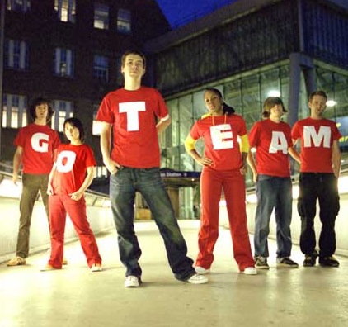
How we work together?
What to do?
Knowing each other.
Decide how to work most effectively.
Decision making.
Help each other out.

Slide 5
Our aim: Implement a file synchronization tool to synchronize files between multiple computers. Minimally, it should be able to synchronize a folder in one computer with a folder in another computer using an intermediary storage device.

Slide 6
Knowing each other is very important
Get to know all team members
(1). See their strength and weakness.
(2). Personal interest.

Slide 7
How to work
This means the way we work together. Eg: everyone go back and code individually, or we discuss together then code together.

Slide 8




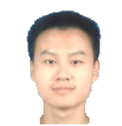



Slide 9

Decision
One person decide something.
The decision must be set fast.
Once made decision, everyone
have to follow it, whenever meet
difficulties, make decision again

Slide 10
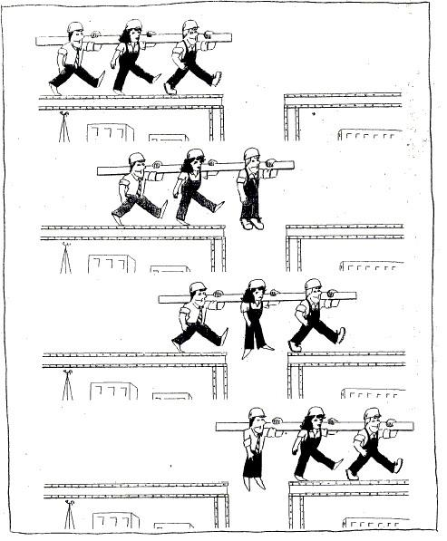
Help each other:

Slide 11
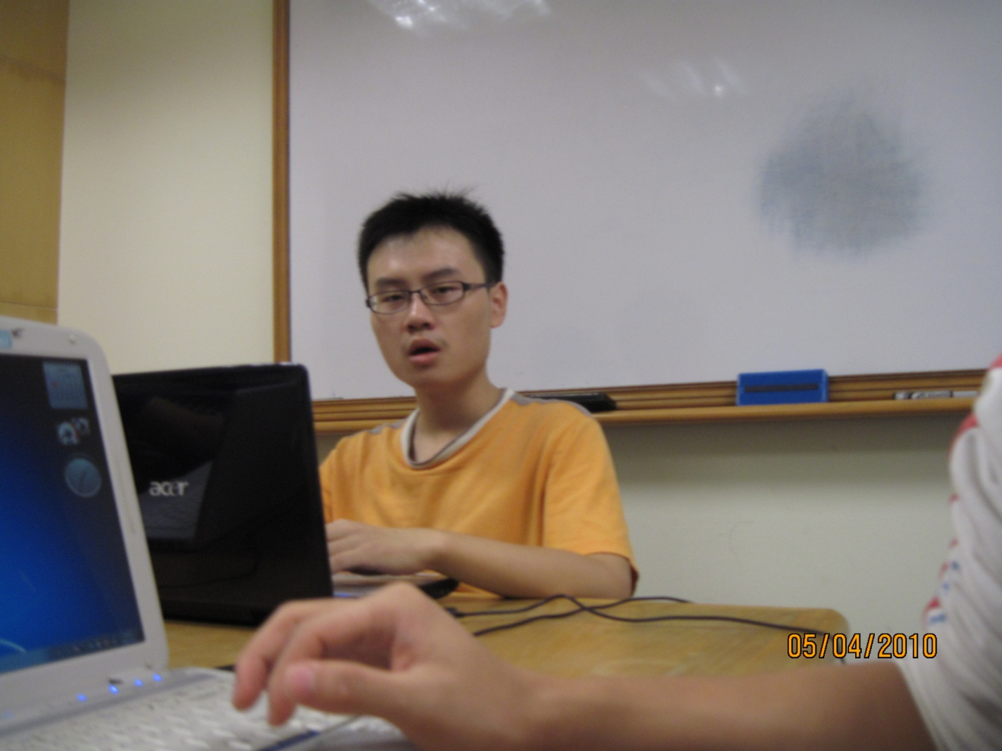
Be aware of the overall status of the product
Next deadline?
Current version?
GUI?
Documentation?
Any critical bugs not solved?
Outstanding issues?
Lightning talk??
?
?
?

Slide 12
Know your team
Know when to be a leader, when to be a follower
Help one another out
Be aware of the overall status of the product
Be independent
Be prepared to step out of your comfort zone
You are part of the group, the group is not part of you
Enjoy the process!

